Slide 1
PaperClip: rapid multi-part DNA assembly from existing libraries.
Trubitsyna, Maryia, Gracjan Michlewski, Yizhi Cai, Alistair Elfick, and Christopher E. French.
Nucleic acids research42, no. 20 (2014): e154-e154.
Course No: B206; Pre II
Deng Luo; Dec 10 2018

Slide 2
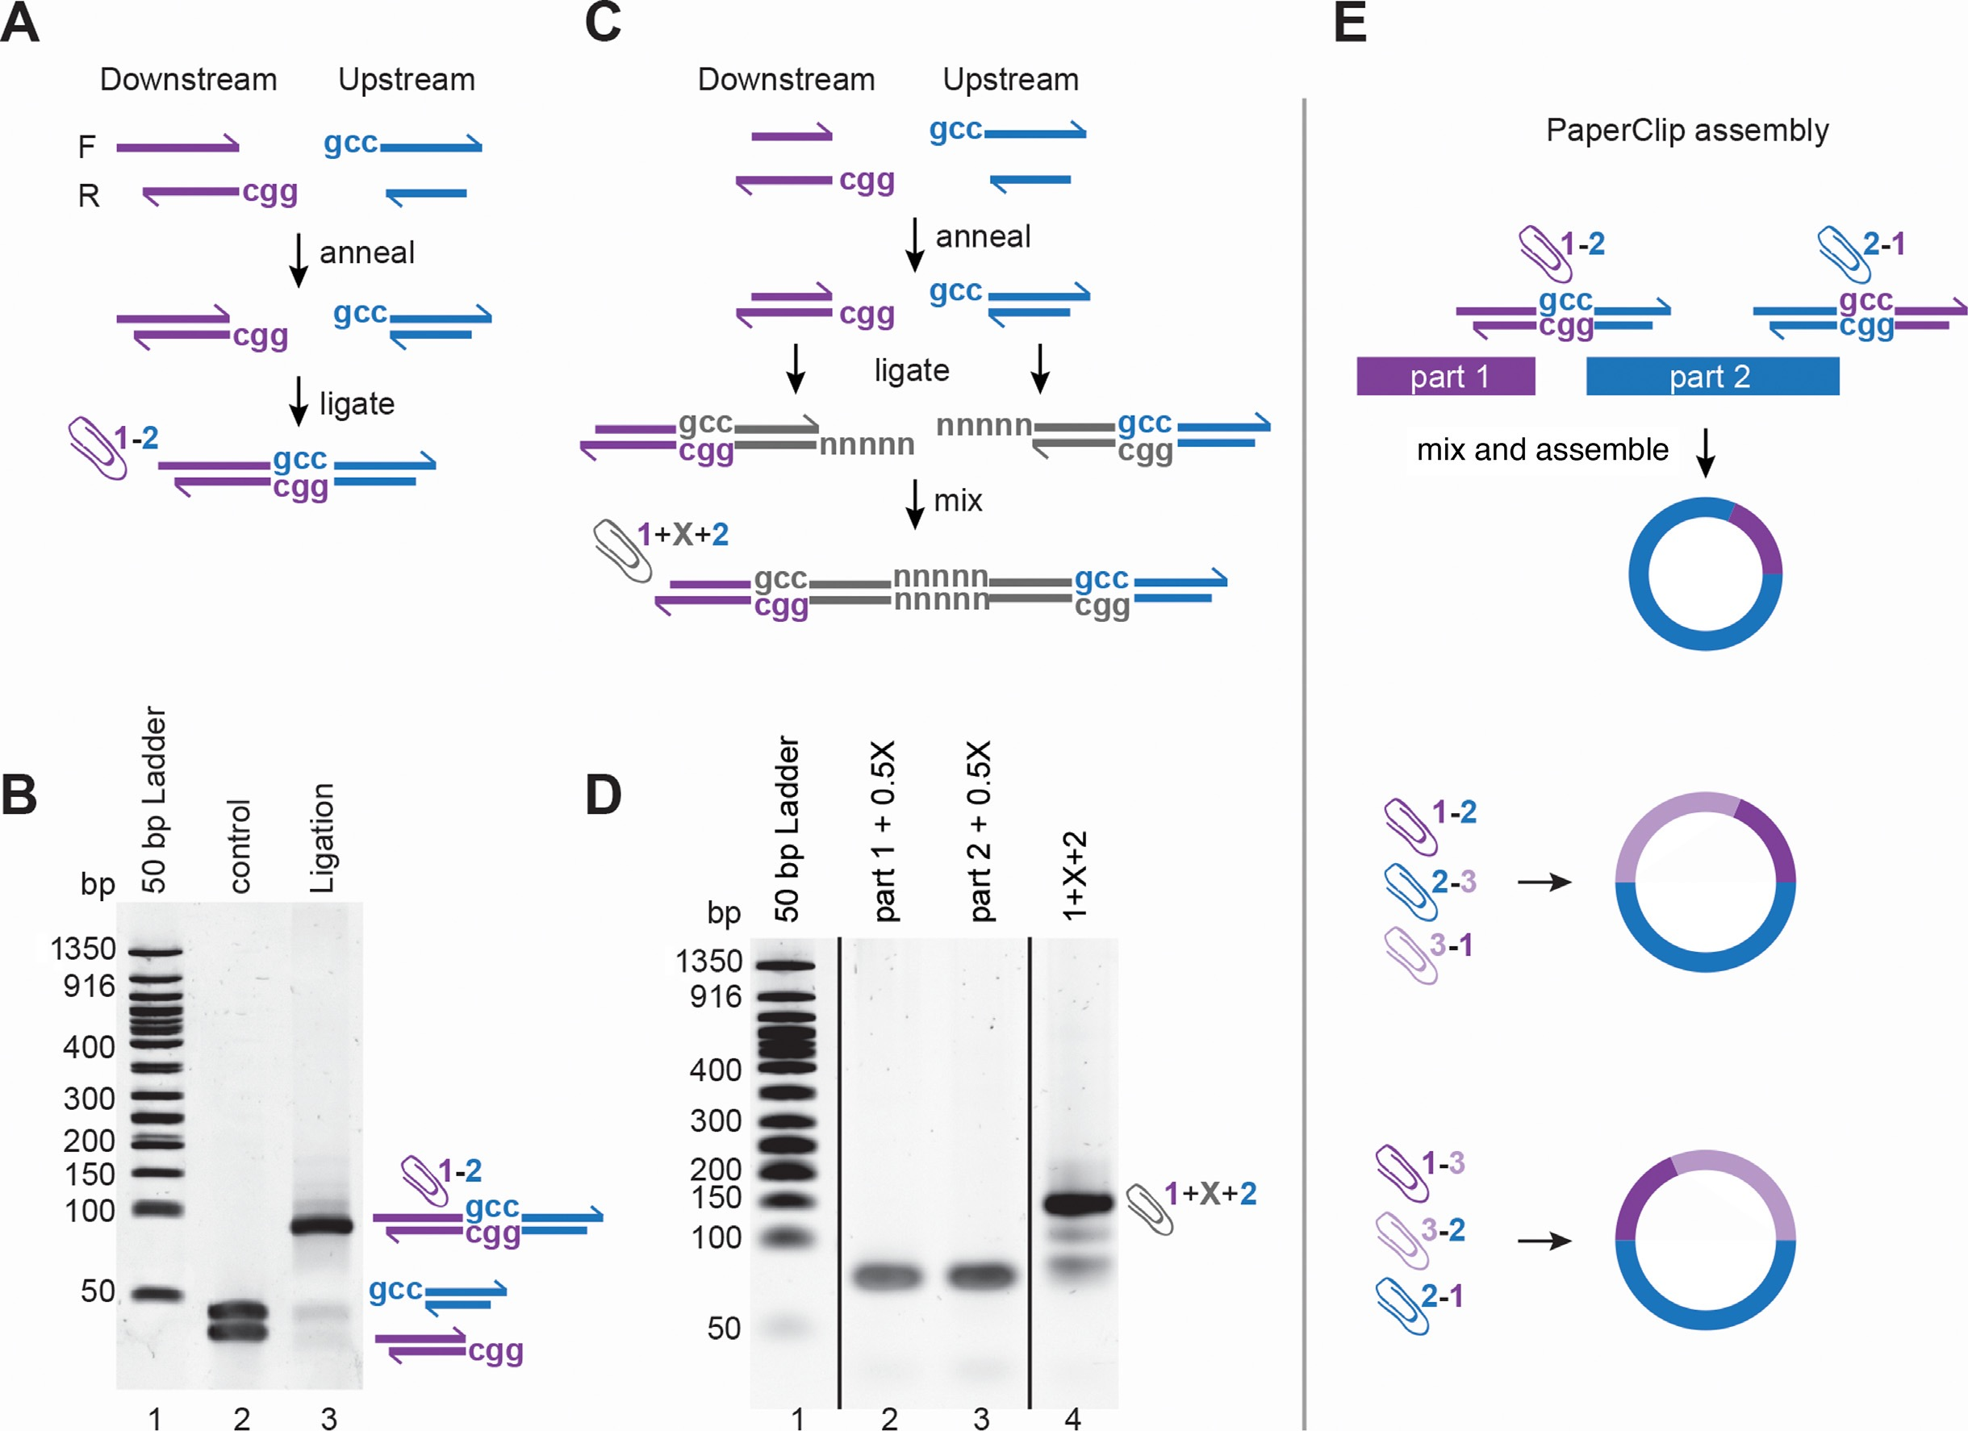
Background: DNA assembly methods
End-homology based methods:
Gibson, SLiCE, SLIC; homology required; new primers for each assembly
Type IIS restriction enzymes based:
Golden Gate, MoClo, GoldenBraid; well control of the restriction sites
Recent bridging oligonucleotides:
new oligonucleotides to be synthesized for each assembly
Here:
DNA assembly using double stranded bridging oligonucleotides––Clips. PCR or E. coli cell extract.
Kok, ACS syn bio 3.2 (2014): 97-106.
wikipedia
NEB

Slide 3
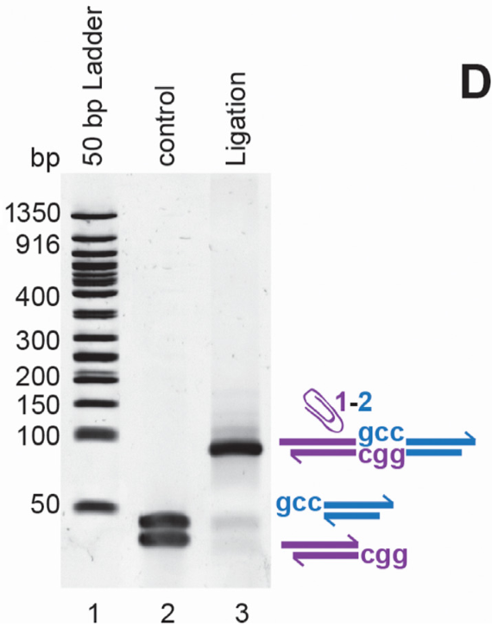
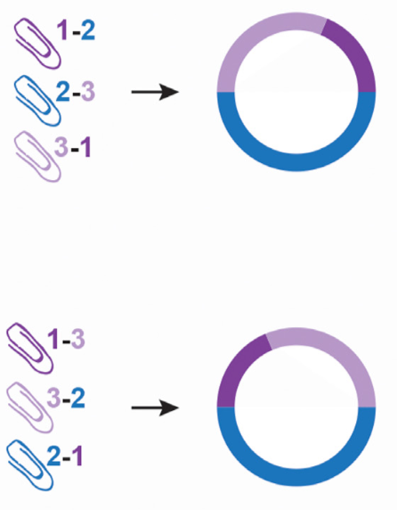
PaperClip Overview
Design/preparation of Clip oligonucleotides
~ 40 bp
Customizable homology (sticky ends),
GCC
CGG
The ligation reaction is correct and efficient
Capable of circularizing
Fine order control
Reusable half clips

Slide 4
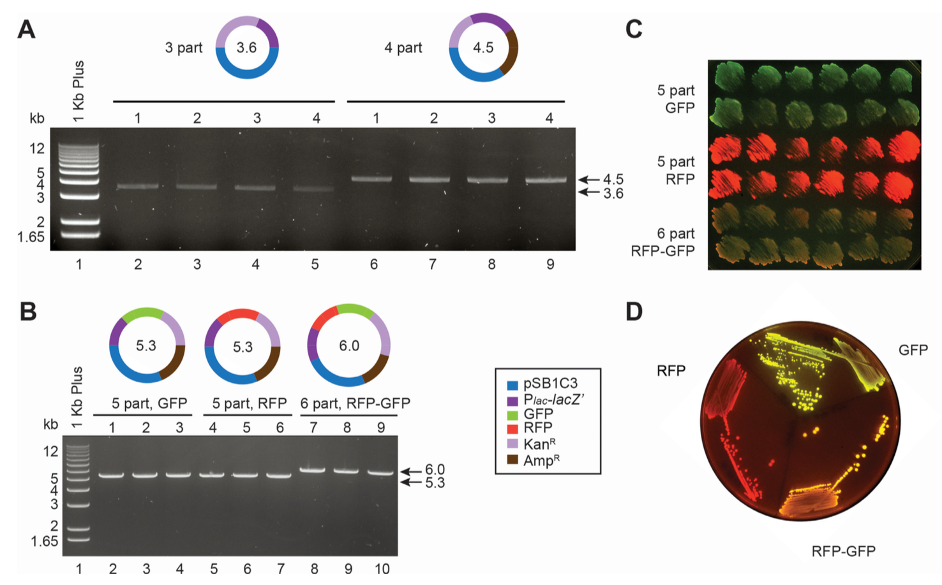
Analysis of the products from three-, four-, five-, and six-part assemblies.
Restriction digest of
3
4
5
6 parts assemblies
The ligation reaction is correct and efficient
Phenotype confirmation:
12 colonies
induced by IPTG
GFP/RFP
Purity confirmation:
One clone streaked out to single colonies

Slide 5
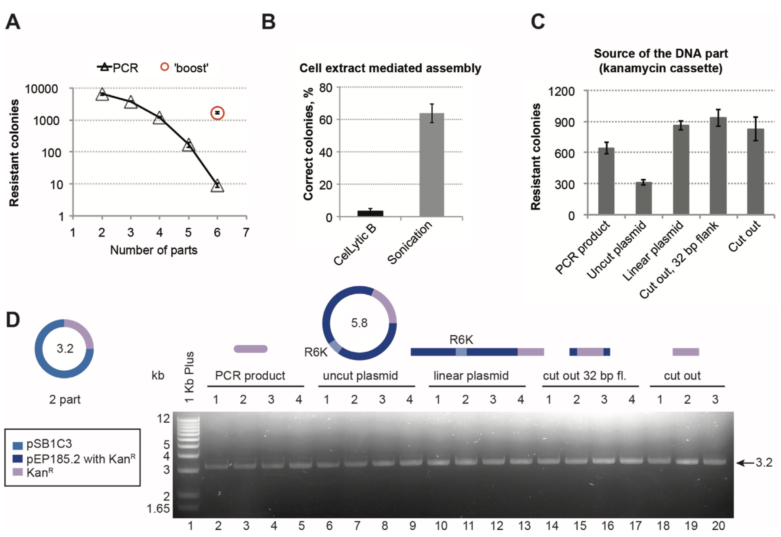
Optimization of PaperClip efficiency.
↑ # assembly parts, ↓ efficiency
‘boost’ PCR reaction gave a 150-fold increase
Extracts after sonication of the E. coli DH10B Red/ET cells showed 20× higher efficiency.
All five forms of source DNA works with PaperClip, shown in:
# colonies
Restriction digestion

Slide 6
Discussion
Efficient & effective. No re-cloning or amplification. Only Four short oligonucleotides per part is needed. Bypass internal restriction sites problem. Cost effective (polynucleotide kinase, T4 DNA ligase and a proofreading polymerase).
Homology based. The final constructs cannot contain repetitive parts or more than 40 bases of identical regions.
PaperClip assembly will contain a GCC tri-nucleotide seam (‘scar’) between each part. CTA in “BrickClip” for multi-part BioBrick assembly.
No need to obtain new oligonucleotides for each assembly involving a different order of parts. This reduces cost and preparation time for assemblies.
Easily amenable to automation.
Thank You!

